Slide 1
Unit 8 Virtual Private Networks (VPN)
8.1 Private and hybrid networks?
8.2 VPN devices
8.3 VPN technologies and protocols
8.4 Modeling and characterizing VPNs
8.5 Other methods of categorizing VPNs
8.6 How VPN works?
8.7 Component types
8.8 Summary

Slide 2
Private and hybrid networks
Previous units describe a single-level abstraction of the internet
Major drawback: lack of privacy
An alternative – a two-level internet architecture distinguishes between internal and external datagrams
Each organization has a private internet and a central internet interconnects them
Goal: to keep internal datagrams private while still allowing external communication

Slide 3
Private networks
A private network is a network that uses private IP address space, following the standards set by RFC 1918 and RFC 4193.
These addresses are commonly used for home, office, and enterprise LANs.
Private addresses are not globally delegated. Using these addresses do not need approval from a regional Internet registry (RIR).
Privately addressed IP packets cannot be transmitted onto the public Internet.
In order to connect to the Internet, either a network address translator (NAT) gateway, or a proxy server is needed

Slide 4
Private IPv4 addresses (RFC 1918)
RFC1918 name | IP address range | number of addresses | classful description | largest CIDR block (subnet mask) | host id size
24-bit block | 10.0.0.0 – 10.255.255.255 | 16,777,216 | single class A | 10.0.0.0/8 (255.0.0.0) | 24 bits
20-bit block | 172.16.0.0 – 172.31.255.255 | 1,048,576 | 16 contiguous class Bs | 172.16.0.0/12 (255.240.0.0) | 20 bits
16-bit block | 192.168.0.0 – 192.168.255.255 | 65,536 | 256 contiguous class Cs | 192.168.0.0/16 (255.255.0.0) | 16 bits
The concept of private networks and special address reservation for such networks has been carried over to IPv6

Slide 5
Virtual Private Networks (VPNs)
Institutions often want private networks for security.
Costly! Separate routers, links, DNS infrastructure
With a VPN, institution’s inter-office traffic is sent over public Internet instead.
But inter-office traffic is encrypted before entering public Internet

Slide 6
Private Networks vs. Virtual Private Networks
Employees can access the network (Intranet) from remote locations
Secured networks
The Internet is used as the backbone for VPNs
Saves cost tremendously from reduction of equipment and maintenance costs
Scalability

Slide 7
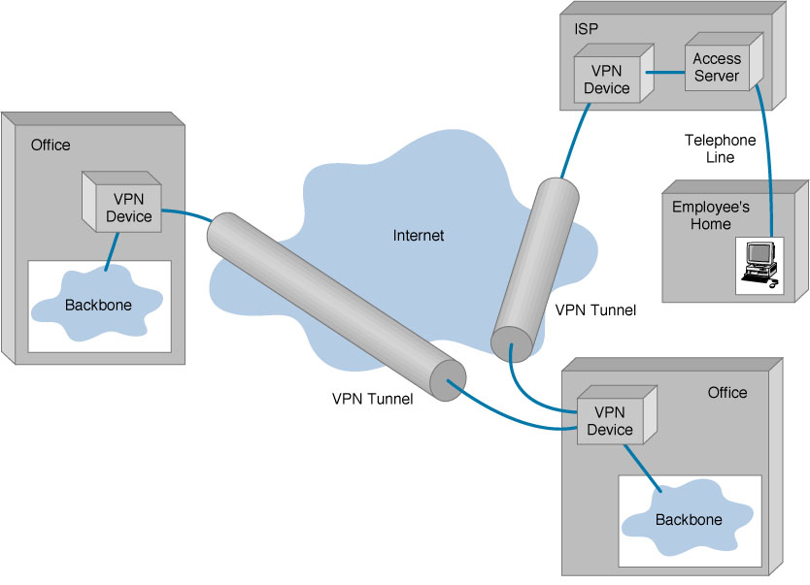
Basic architecture

Slide 8
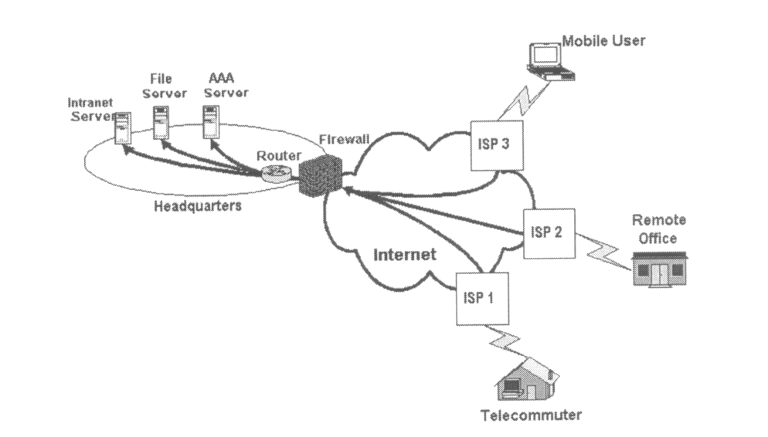
Remote Access Virtual Private Network
(From Gartner Consulting)

Slide 9
Unit 8 Virtual Private Networks (VPN)
8.1 Private and hybrid networks?
8.2 VPN devices
8.3 VPN technologies and protocols
8.4 Modeling and characterizing VPNs
8.5 Other methods of categorizing VPNs
8.6 How VPN works?
8.7 Component types
8.8 Summary

Slide 10
Devices in the customer network
Customer (C) devices
simply devices such as routers and switches
located within the customer network
no direct connectivity to the service provider network
unaware of the VPN
Customer Edge (CE) devices
located at the edge of the customer network and connect to the provider network (via Provider Edge [PE] devices)
aware of the VPN in CE-based VPNs
unaware of the VPN in PE-based VPNs
categorized as either Customer Edge routers (CE-r), or Customer Edge switches (CE-s)

Slide 11
Devices in the service provider network in a site-to-site VPN
Service Provider (P) devices
devices such as routers and switches
within the provider network that do not directly connect to customer networks.
unaware of customer VPNs
Service Provider Edge (PE) devices
connect directly to customer networks via CE devices
aware of the VPN in PE-based VPNs
but unaware of the VPN in CE-based VPNs
three types of PE device:
Provider Edge routers (PE-r)
Provider Edge switches (PE-s)
Provider Edge devices that are capable of both routing and switching (PE-rs)

Slide 12
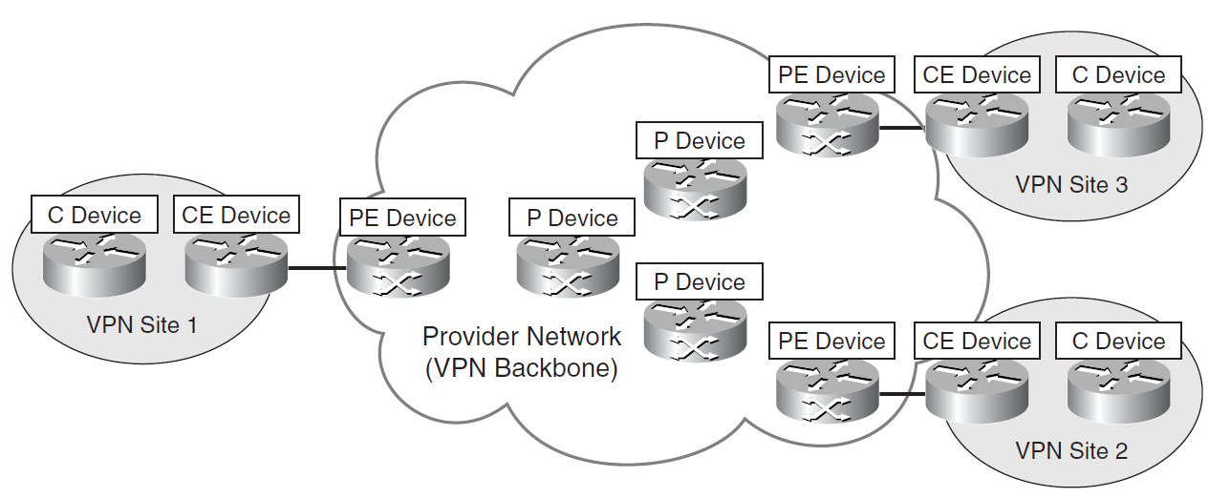
Customer and provider network devices

Slide 13
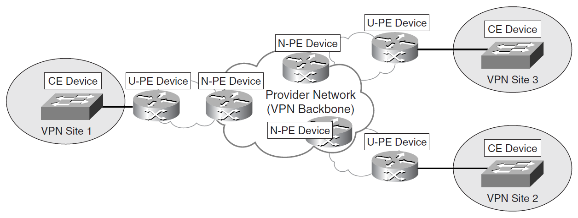
User-facing and network-facing PE devices
In Layer 2 VPNs, e.g., Virtual Private LAN Service (VPLS), introduction of an additional level to improve scalability → Hierarchical VPLS [H-VPLS]
PE device is divided between a User-facing PE (U-PE) devices and Network-facing PE (N-PE) devices.

Slide 14
Other VPN device types
Network Access Servers (NAS)
a device that interfaces between an access network and a packet-switched network
serve as a tunnel endpoint in a remote access VPN
VPN gateways/concentrators
act as the endpoint of a VPN tunnel, especially in a remote access VPN or CE-based site-to-site VPN

Slide 15
Unit 8 Virtual Private Networks (VPN)
8.1 Private and hybrid networks?
8.2 VPN devices
8.3 VPN technologies and protocols
8.4 Modeling and characterizing VPNs
8.5 Other methods of categorizing VPNs
8.6 How VPN works?
8.7 Component types
8.8 Summary

Slide 16
VPN Technologies and Protocols for site-to-site VPNs
IP security (IPsec) — designed to protect IP traffic between security gateways or hosts as it transits an intervening network.
Generic Routing Encapsulation (GRE) — to construct tunnels and transport multiprotocol traffic between CE devices in a VPN. GRE has little or no inherent security, but GRE tunnels can be protected using IPsec.
Draft Martini pseudowires (emulated circuits, Any Transport over MPLS [AToM]) — allows point-to-point transport of protocols such as Frame Relay, ATM, Ethernet, Ethernet VLAN (802.1Q), High-Level Data Link Control (HDLC), and PPP traffic over MPLS.
Layer Two Tunneling Protocol version 3 (L2TPv3) — allows the point-to-point transport of protocols over an IP or other backbone.
IEEE 802.1Q tunneling (Q-in-Q) — 802.1Q tunneling allows a service provider to tunnel tagged Ethernet (802.1Q) customer traffic over a shared backbone.
MPLS LSPs

Slide 17
VPN Technologies and Protocols for Remote Access VPNs
The Layer Two Forwarding (L2F) Protocol — a Cisco proprietary protocol that is designed to allow the tunneling of PPP (or Serial Line Interface Protocol [SLIP]) frames between a NAS and a VPN gateway device located at a central site
The Point-to-Point Tunneling Protocol (PPTP)
L2TPv2/L2TPv3 — L2TP has limited intrinsic security, and so L2TP tunnels are often protected using IPsec.
IPsec — As well as enabling site-to-site VPNs, IPsec can also be used to securely tunnel data traffic between remote access or mobile users and a VPN gateway/concentrator
Secure Sockets Layer (SSL) — a security protocol that was originally developed by Netscape Communications

Slide 18
SSL
Later developed into Transport Layer Security (TLS), an IETF standard, is similar to SSLv3.
usually implemented on top of any of the Transport Layer protocols
sometimes referred to as web VPNs or clientless VPNs because no special client software is required other than a web browser
More functionality can be added by installing SSL VPN client software on remote access client devices

Slide 19
Unit 8 Virtual Private Networks (VPN)
8.1 Private and hybrid networks?
8.2 VPN devices
8.3 VPN technologies and protocols
8.4 Modeling and characterizing VPNs
8.5 Other methods of categorizing VPNs
8.6 How VPN works?
8.7 Component types
8.8 Summary

Slide 20
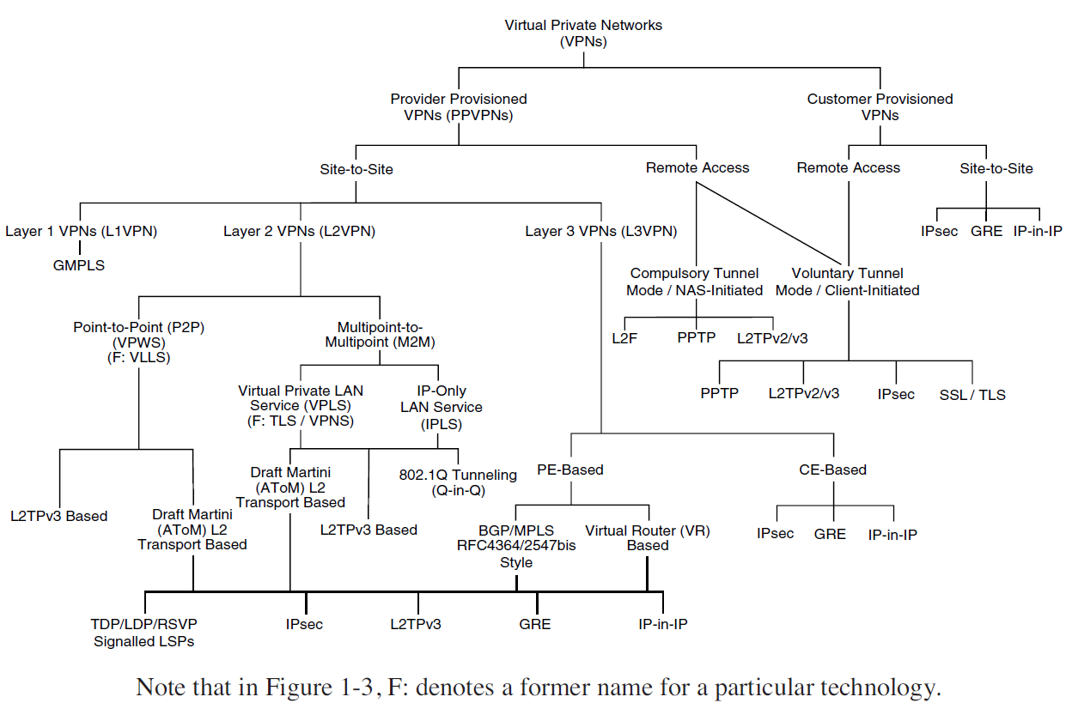
Modelling and Characterizing VPNs

Slide 21
Service Provider and Customer Provisioned VPNs
Service provider provisioned VPNs
configured and managed by a service provider or providers
a VPN service might be offered over the backbone networks of multiple cooperating autonomous systems and/or service providers (an inter-AS or interprovider VPN service)
Customer provisioned VPNs
configured and managed by the (service provider) customer itself
Note: the customer of the service provider may be either an enterprise or another service provider

Slide 22
Site-to-Site and Remote Access VPNs
Another two broad categories:
Site-to-site VPNs
allow connectivity between an organization’s (or organizations’) geographically dispersed sites (such as a head office and branch offices).
two types of site-to-site VPN:
Intranet VPNs—Allow connectivity between sites of a single organization
Extranet VPNs—Allow connectivity between organizations such as business partners or a business and its customers
Remote access VPNs
allow mobile or home-based users to access an organization’s resources remotely.

Slide 23
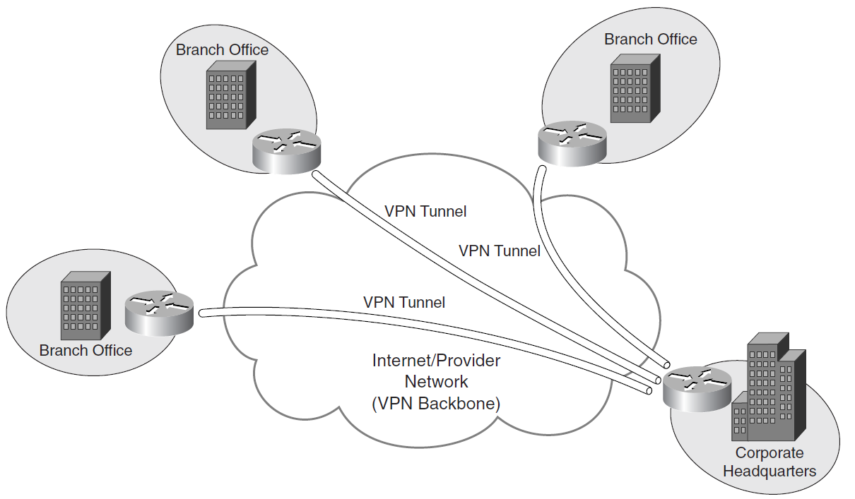
Typical Site-to-Site VPN

Slide 24
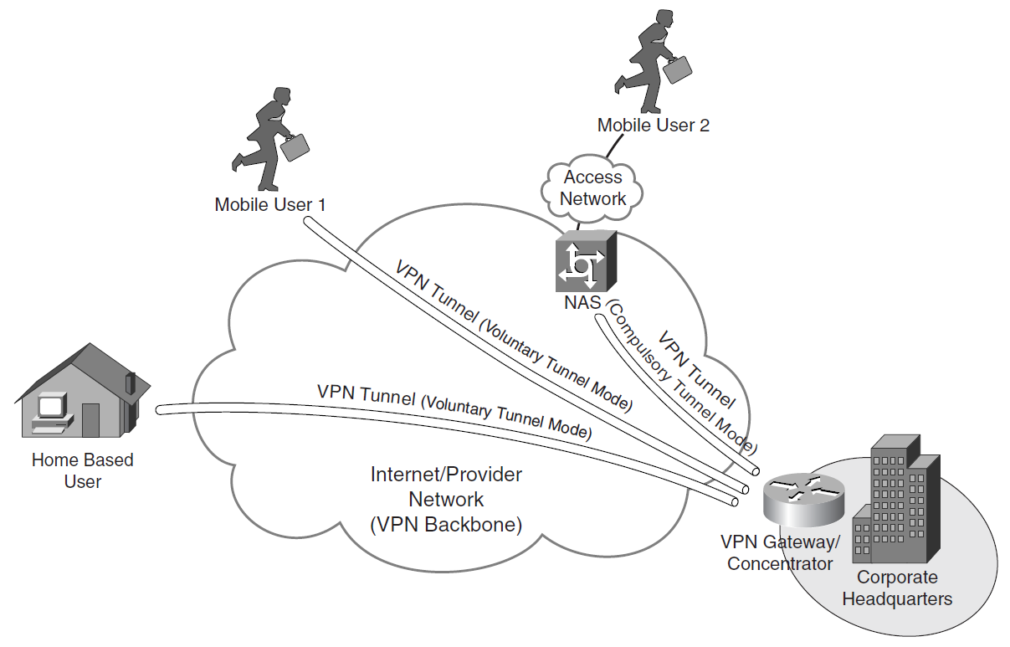
Remote Access VPNs

Slide 25
Service Provider Provisioned Site-to-Site VPNs
Layer 1 VPNs (L1VPNs)
transport Layer 1 services by Generalized Multiprotocol Label Switching (GMPLS), which is in its relative infancy
Layer 2 VPNs (L2VPN)
provisioned between switches, hosts, and routers and allow data link layer connectivity between separate sites
based on Layer 2 addressing, and PE devices perform forwarding based on incoming link and Layer 2 header information (e.g., MAC address)
Layer 3 VPNs (L3VPN)
interconnect hosts and routers at separate sites.
communicate based on Layer 3 addressing, and PE devices forward traffic based on incoming link, and on addresses contained in the (outer) IP header.

Slide 26
Two overall types of L3VPN
PE-based VPNs
Traffic is forwarded between PE devices over VPN tunnels
CE devices are not aware that they are participating in a VPN
PE-based VPNs are also sometimes referred to as Network-based VPNs
CE-based VPNs
PE devices do not participate in (and are unaware of) customer network routing
forward customer traffic based on globally unique addressing
tunnels are configured between CE devices

Slide 27
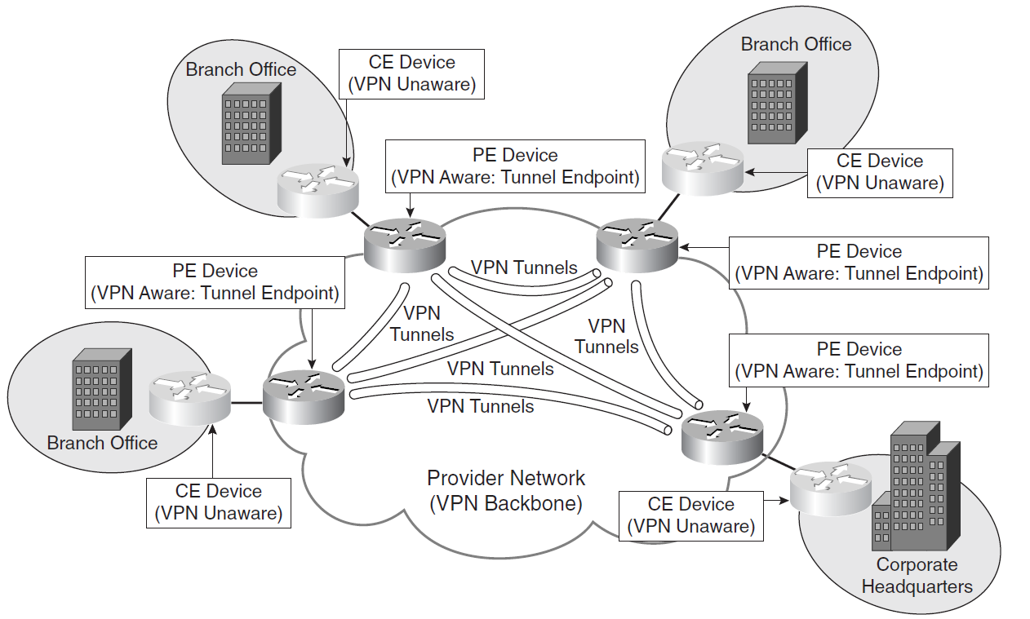
Typical PE-based site-to-site VPN

Slide 28
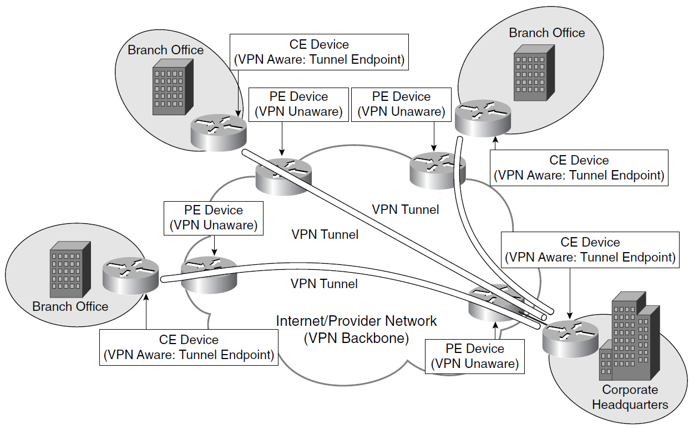
Typical CE-based site-to-site VPN

Slide 29
Unit 8 Virtual Private Networks (VPN)
8.1 Private and hybrid networks?
8.2 VPN devices
8.3 VPN technologies and protocols
8.4 Modeling and characterizing VPNs
8.5 Other methods of categorizing VPNs
8.6 How VPN works?
8.7 Component types
8.8 Summary

Slide 30
Overlay and Peer-to-Peer VPNs
Overlay VPNs
a VC or tunnel connects CE devices, no routing information is exchanged with the service provider (PE devices)
Examples: those built using Frame Relay or ATM virtual circuits, as well as those built using GRE or IPsec tunnels
Peer VPNs
PE devices are aware of customer network addressing and route customer data traffic according to customer network addressing
In peer VPNs, routes are exchanged between CE devices and PE devices.
Example: BGP/MPLS (RFC4364/2547bis) VPNs.

Slide 31
Connection-Oriented and Connectionless VPNs
Depending on whether VCs or tunnels are provisioned to carry VPN traffic.
Connection-oriented VPNs
VCs or tunnels are set up to carry VPN traffic.
Examples: those provisioned using Frame Relay or ATM VCs, as well as those provisioned using L2TP or IPsec tunnels
Connectionless VPNs
neither VCs nor tunnels are set up to carry VPN traffic.
PE-based VPNs that rely on the partitioning of customer data traffic by using access control lists (ACLs) configured on PE devices

Slide 32
Trusted and Secure VPNs
Depending on whether customer data traffic is authenticated and encrypted as it passes between VPN peers
Trusted VPNs
Provisioned by a service provider
customers trust the service provider though its traffic is not encrypted over backbone
Examples of trusted VPNs are Frame Relay, ATM, and BGP/MPLS (RFC4364/2547bis) VPNs.
Secure VPNs
Customer traffic data is authenticated and encrypted over the service provider backbone or Internet between VPN peers.
Examples: IPsec VPNs, SSL VPNs, PPTP VPNs secured with MPPE, and L2TP VPNs secured using IPsec.

Slide 33
Unit 8 Virtual Private Networks (VPN)
8.1 Private and hybrid networks?
8.2 VPN devices
8.3 VPN technologies and protocols
8.4 Modeling and characterizing VPNs
8.5 Other methods of categorizing VPNs
8.6 How VPN works?
8.7 Component types
8.8 Summary

Slide 34
Brief Overview of How VPN Works
Two connections – one is made to the Internet and the second is made to the VPN
Datagrams – contains data, destination and source information
Firewalls – VPNs allow authorized users to pass through the firewalls
Protocols – protocols create the VPN tunnels

Slide 35
What a VPN needs
VPNs must be encrypted
so no one can read it
VPNs must be authenticated
No one outside the VPN can alter the VPN
All parties to the VPN must agree on the security properties

Slide 36
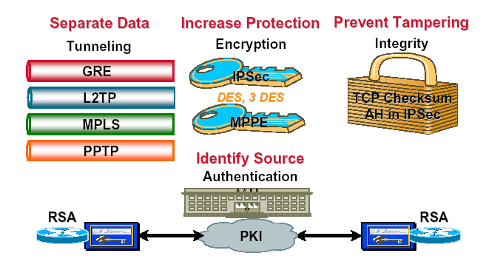
VPN Components

Slide 37
Four Critical Functions
Authentication – validates that the data was sent from the sender.
Access control – limiting unauthorized users from accessing the network.
Confidentiality – preventing the data to be read or copied as the data is being transported.
Data Integrity – ensuring that the data has not been altered

Slide 38
Tunneling
A virtual point-to-point connection made through a public network. It transports encapsulated datagrams.
Original Datagram
Encrypted Inner Datagram
Datagram Header Outer Datagram Data Area
Data Encapsulation [From Comer]
Two types of end points:
Remote Access
Site-to-Site

Slide 39
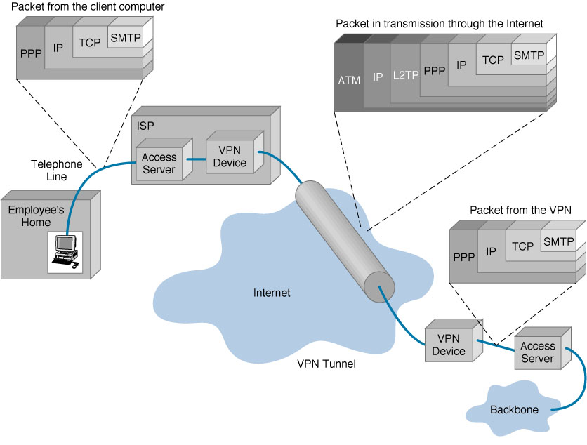
VPN Encapsulation of Packets

Slide 40
Tunnelling (1)
Local addresses
Global addresses
Local addresses
125.1.2.3
tunnel
194.4.5.6
site B
Y
X
site A
R₁
R₂
10.2.0.3
10.1.0.1
Internet
Network address = 10.1.0.0
（local address）
Network address = 10.2.0.0
（local address）

Slide 41
Tunnelling (2)
Encrypted inner datagram (X-->Y)
source：125.1.2.3
destination：194.4.5.6
Outer datagram data area
Datagram
header
125.1.2.3
tunnel
194.4.5.6
site B
Y
X
site A
R₁
R₂
10.2.0.3
10.1.0.1
Internet
125.1.2.3
194.4.5.6
R₁
R₂
Y
X
site B
site A
10.2.0.3
10.1.0.1
VPN

Slide 42
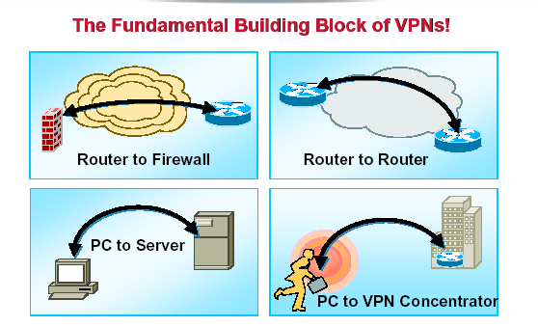
VPN Building blocks

Slide 43
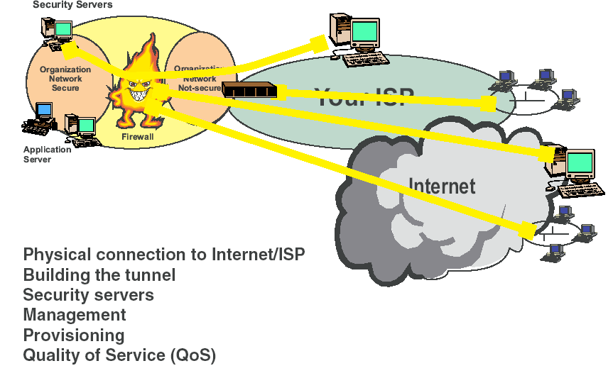
Parts of a VPN

Slide 44
Encryption
Encryption -- is a method of “scrambling” data before transmitting it onto the Internet.
Public Key Encryption Technique
Digital signature – for authentication

Slide 45
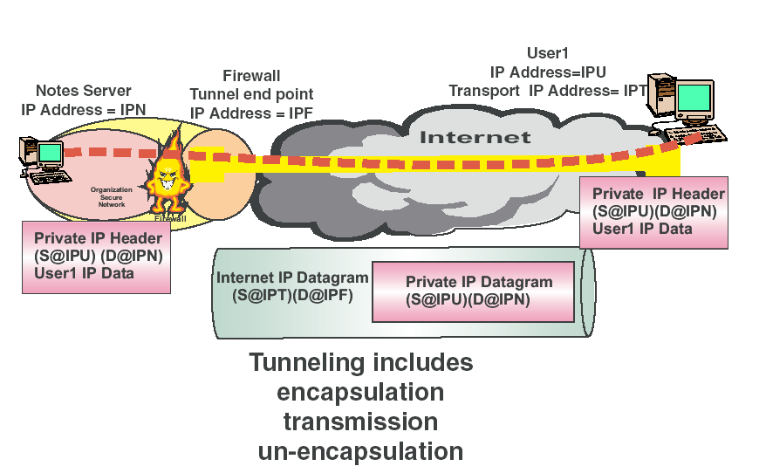
VPN works via crypto/Encapsulation

Slide 46
Encryption and Decryption
Clear-Text
Clear-Text
Bob Is a Fink
Bob Is a Fink
8vyaleh31&d
ktu.dtrw8743
$Fie*nP093h
Encryption
Decryption
Cipher Text
Notes:
11
43
43

Slide 47
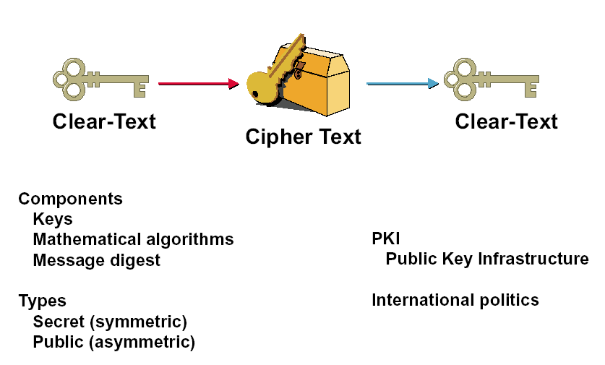
Basic Crypto – Keys are key

Slide 48
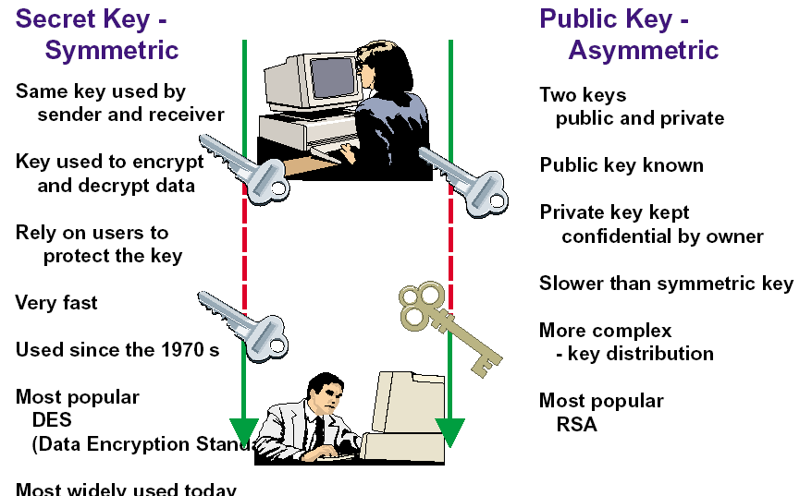
2 Kinds of Key Systems

Slide 49
Public Key Encryption Example
Alice wants to send Bob encrypted data
Alice gets Bob’s public key
Alice encrypts the data with Bob’s public key
Alice sends the encrypted data to Bob
Bob decrypts the data with his private key
Alice
Bob
Message
Encrypted
Message
Message
Encryption
Decrypt
Bob’s Public Key
Bob’s Private Key
Notes:
13
49
49

Slide 50
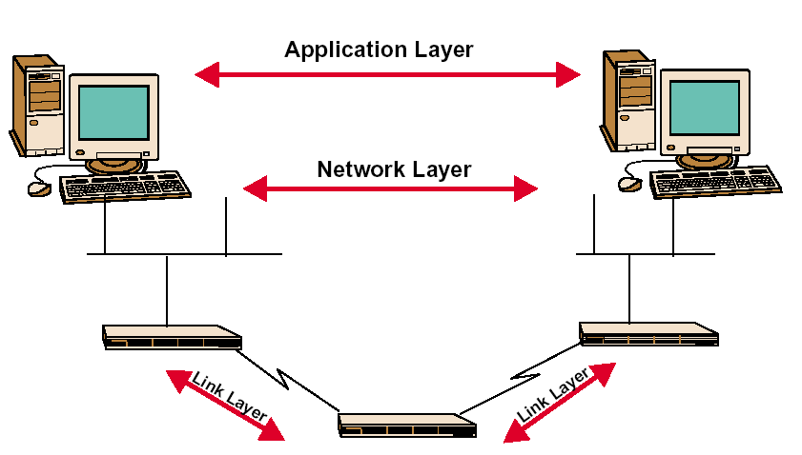
Where you do Crypto

Slide 51
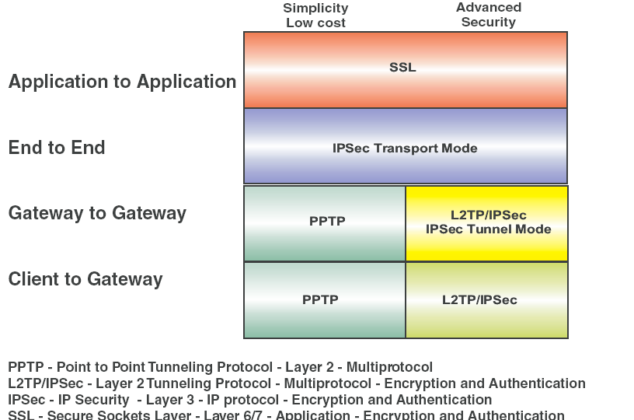
Different layer technologies

Slide 52
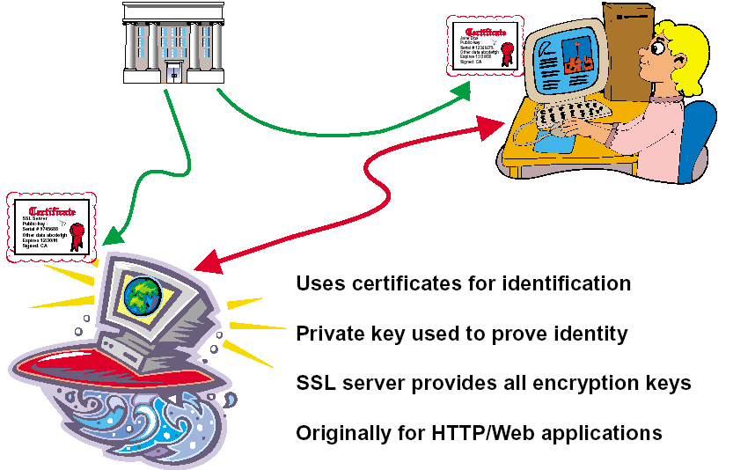
Application Layer: SSL

Slide 53
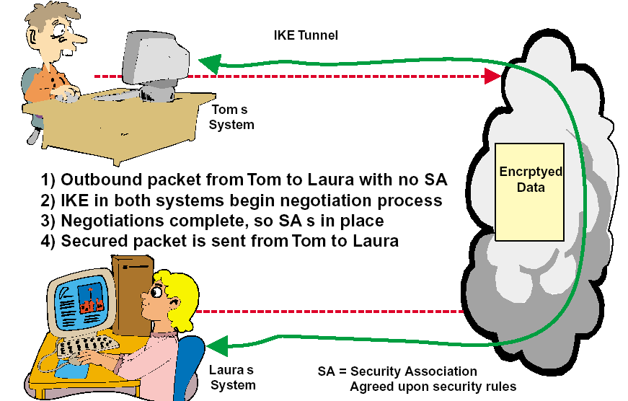
Security Association (SA) is the agreement on how to secure
IKE – Internet Key Exchange protocol

Slide 54
Security Association (SA)
IPsec datagrams are sent between pairs of network entities,
such as between two hosts, between two routers, or between a host and router.
Before sending IPsec datagrams from source entity to destination entity, the source and destination entities create a network-layer logical connection – called a security association (SA)
An SA is a simplex logical connection, i.e., unidirectional from source to destination.
If both entities want to send secure datagrams to each other, then two SAs need to be established, one in each direction.

Slide 55
IPsec Datagram
IPsec has two different packet forms: tunnel mode and transport mode.
The tunnel mode, being more appropriate for VPNs, is more widely deployed than the transport mode.
IPsec provides—between any pair of devices that process packets through the network layer—confidentiality, source authentication, data integrity, and replay-attack prevention.

Slide 56
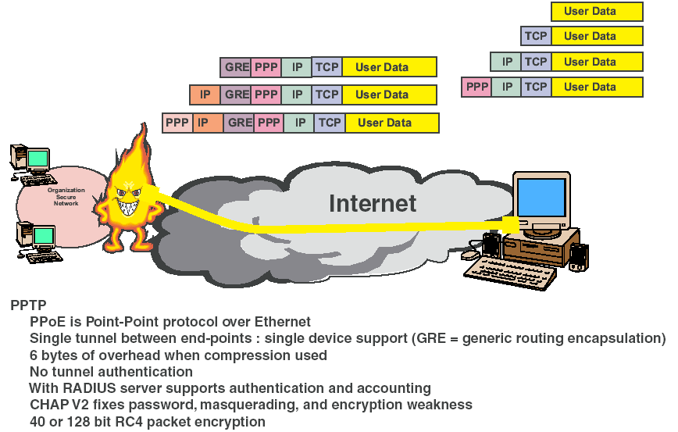
PPTP: Free from Microsoft

Slide 57
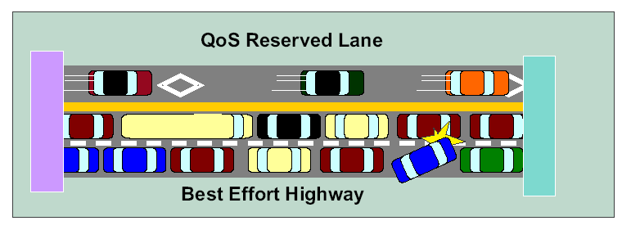
So why have a private network: QoS not fully cooked
Very dependent on your ISP
Real hard to do across ISPs
So no guarantee of performance

Slide 58
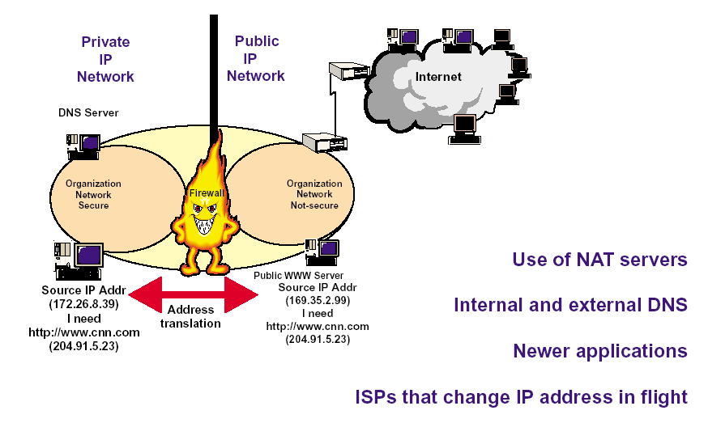
Other Issues

Slide 59
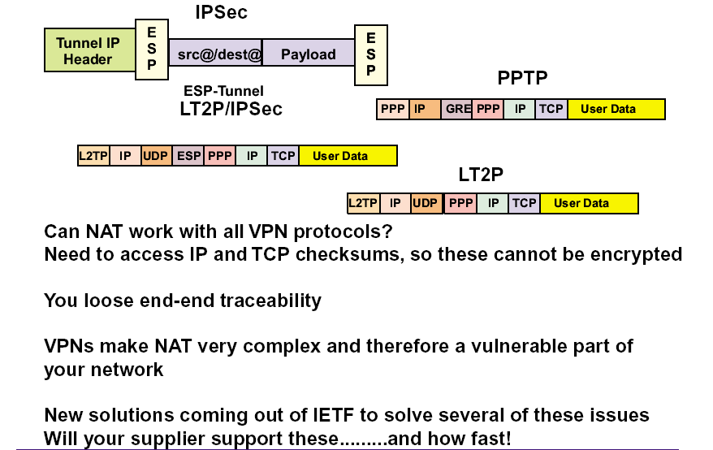
Like NAT

Slide 60
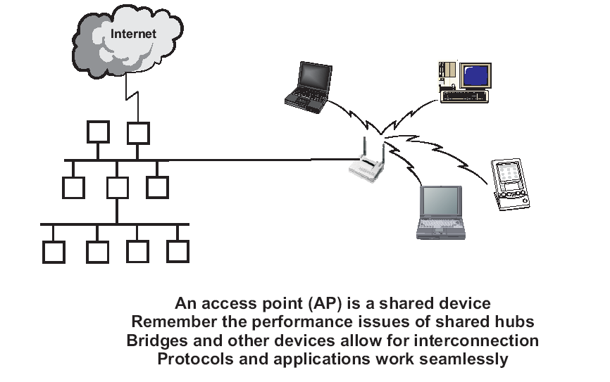
Wireless: a new big driver, WAS (Work At Starbucks)

Slide 61
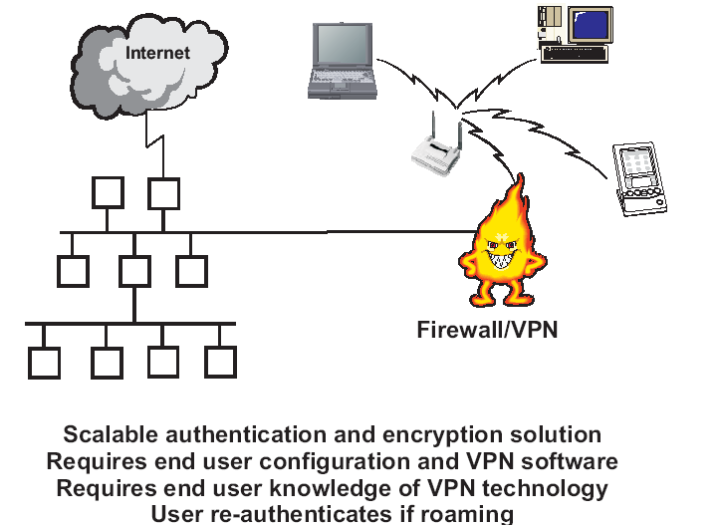
VPN means I don’t care how you connect

Slide 62
So what could be wrong?
VPN clients hit the network stack
May not play well with personal firewalls or other software
May not need full access to the target network just encrypted access

Slide 63
One answer: clientless VPN
Use SSL as the transport protocol to an appliance
Can add NT authentication to the appliance
Clientless mode: Use web enabled applications over the Internet, the appliance SSLifies web sites
Java Applet: Use an downloadable applet to send traffic over SSL, get more support for applications.
Can work well if you want to have encrypted web based apps without redoing the application
to use SSL you need certs and have to change EVERY link to HTTPs
Also big hit on the server CPU

Slide 64
Unit 8 Virtual Private Networks (VPN)
8.1 Private and hybrid networks?
8.2 VPN devices
8.3 VPN technologies and protocols
8.4 Modeling and characterizing VPNs
8.5 Other methods of categorizing VPNs
8.6 How VPN works?
8.7 Component types
8.8 Summary

Slide 65
Component Types
What it means
3 types
Hardware
Firewall
Software

Slide 66
Hardware
Usually a VPN type of router
Pros
Highest network throughput
Plug and Play
Dual-purpose
Cons
Cost
Lack of flexibility

Slide 67
Firewall
More security?
Pros
“Harden” Operating System
Tri-purpose
Cost-effective
Cons
Still relatively costly

Slide 68
Software
Ideal for 2 end points not in same org.
Great when different firewalls implemented
Pros
Flexible
Low relative cost
Cons
Lack of efficiency
More labor training required
Lower productivity; higher labor costs

Slide 69
Unit 8 Virtual Private Networks (VPN)
8.1 Private and hybrid networks?
8.2 VPN devices
8.3 VPN technologies and protocols
8.4 Modeling and characterizing VPNs
8.5 Other methods of categorizing VPNs
8.6 How VPN works?
8.7 Component types
8.8 Summary

Slide 70
Summary: VPNs
Very big in the work access space
Exploit High speed
Wireless
in the office
public ‘hot spots’ like Borders
Replaces direct dial into the work network
Replace dedicated Business partners
May replace the corporate WAN

Slide 71
Advantages: Cost Savings
Eliminating the need for expensive long-distance leased lines
Reducing the long-distance telephone charges for remote access.
Transferring the support burden to the service providers
Operational costs

Slide 72
Advantages: Scalability
Flexibility of growth
Efficiency with broadband technology

Slide 73
Disadvantages
VPNs require an in-depth understanding of public network security issues and proper deployment of precautions
Availability and performance depends on factors largely outside of their control
Immature standards
VPNs need to accommodate protocols other than IP and existing internal network technology

Slide 74
Applications: Site-to-Site VPNs
Large-scale encryption between multiple fixed sites such as remote offices and central offices
Network traffic is sent over the branch office Internet connection
This saves the company hardware and management expenses

Slide 75
Applications: Remote Access
Encrypted connections between mobile or remote users and their corporate networks
Remote user can make a local call to an ISP, as opposed to a long distance call to the corporate remote access server
Ideal for a telecommuter or mobile sales people
VPN allows mobile workers & telecommuters to take advantage of broadband connectivity i.e. DSL, Cable

Slide 76
Industries that may use a VPN
Healthcare: enables the transferring of confidential patient information within the medical facilities & health care provider
Manufacturing: allow suppliers to view inventory & allow clients to purchase online safely
Retail: able to securely transfer sales data or customer info between stores & the headquarters
Banking/Financial: enables account information to be transferred safely within departments & branches
General Business: communication between remote employees can be securely exchanged

Slide 77
Statistics From Gartner-consulting
*Source: www.cisco.com
VPN 8-77

Slide 78
Pop Quiz!
Q.1
VPN stands for…
a) Virtual Public Network
b) Virtual Private Network
c) Virtual Protocol Network
d) Virtual Perimeter Network

Slide 79
Pop Quiz!
A.1
VPN stands for…
b) Virtual Private Network
VPN stands for "Virtual Private Network" or "Virtual Private Networking." A VPN is a private network in the sense that it carries controlled information, protected by various security mechanisms, between known parties. VPNs are only "virtually" private, however, because this data actually travels over shared public networks instead of fully dedicated private connections.

Slide 80
Pop Quiz!
Q.2
What are the acronyms for the 3 most common VPN protocols?

Slide 81
Pop Quiz!
A.2
3 most common VPN protocols are…
PPTP
L2TP
IPsec
PPTP, IPsec, and L2TP are three of today's most popular VPN tunneling protocols. Each one of these is capable of supporting a secure VPN connection.

Slide 82
Pop Quiz!
Q.3
What does PPTP stand for?

Slide 83
Pop Quiz!
A.3
PPTP = Point-to-Point Tunneling Protocol !

Slide 84
Pop Quiz!
Q.4
What is the main benefit of VPNs compared to dedicated networks utilizing frame relay, leased lines, and traditional dial-up?
a) better network performance
b) less downtime on average
c) reduced cost
d) improved security

Slide 85
Pop Quiz!
A.4
The main benefit of VPNs is…
c) reduced cost
The main benefit of a VPN is the potential for significant cost savings compared to traditional leased lines or dial up networking. These savings come with a certain amount of risk, however, particularly when using the public Internet as the delivery mechanism for VPN data.

Slide 86
Pop Quiz!
Q.5
In VPNs, the term "tunneling" refers to
a) an optional feature that increases network performance if it is turned on
b) the encapsulation of packets inside packets of a different protocol to create and maintain the virtual circuit
c) the method a system administrator uses to detect hackers on the network
d) a marketing strategy that involves selling VPN products for very low prices in return for expensive service contracts

Slide 87
Pop Quiz!
A.5
In VPNs, the term "tunneling" refers to…
b) the encapsulation of packets inside packets of a different protocol to create and maintain the virtual circuit

Slide 88

Homework
Better understanding and description of SSL / TLS. Give at least one example.
Detailed description of Ipsec.
Detailed description of L2TPv3.
Detailed description of GRE.
Detailed description of PPTP.
Directions of development and improvement of VPNs in the future.

